Slide 1
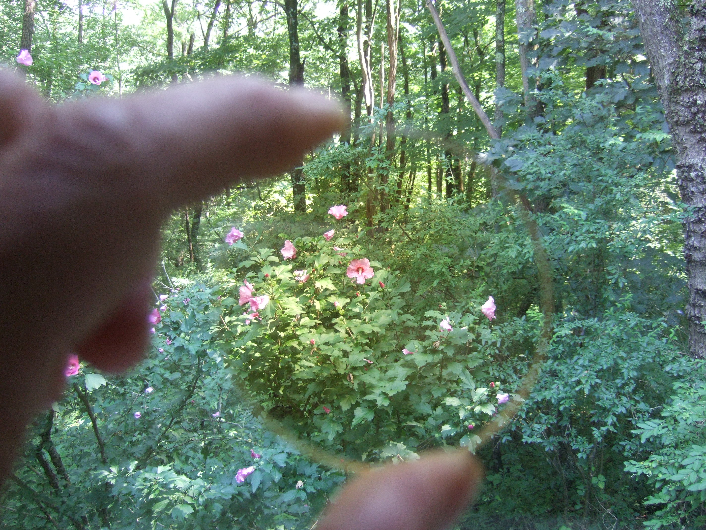
Timm A. Vanderelli Magneto-optic R&D Ferrocell USA
Magnetism and magnetic materials conference 2021
“Enhancing the Modern Innovations and Novel
Improvements in Magnetism and Magnetic Materials”
My presentation is about experiment, observation and measurement of the optical response of a thin-film ferrohydrodynamic fluid in a magnetic field
The Ferrolens
A window into magnetism
Figure 1

Slide 2
Watch the Presentation on YouTube
Watch the presentation on YouTube: https://www.youtube.com/watch?v=-I3HDrR9pts
References and details of the experiments are in the following frames

Slide 3
Links to References
1. Ferrocell®
2. Ferromagnetism
3. Ferrofluid
4. Steric repulsion
5. Superparamagnetic state
6. Rosensweig Instability
7. Van der Waals
8. Pressure gradient instability
9. Superparamagnetic change state to ferromagnetic
10. Repulsive properties and align parallel to the magnetic field
11. Lorentz Force
12. Mie Scattering
13. Dynamic diffraction grating
14. Refractive index of the colloidal
15. Rayleigh Scattering
16. Bloch Wall
17. Dynamic speckle

Slide 4
Links to Related References
Published Papers and Books about the Ferrolens
Light scattering in plateau borders.
Jumping sundogs, cat’s eye and ferrofluids
Observing the jumping laser dogs
Light polarization using ferrofluids and magnetic fields
Investigation of light patterns in a Ferrolens subjected to a magnetic field
Magnetic circles
Extinction of light by a Ferrocell and ferrofluid layers: a comparison
Non-linear stability observation using magneto-controlled diffraction with opto-fluidics
Observing dynamical systems using magneto-controlled diffraction
Optical vortex and Ferrocell: a comparative study
Ferrocell and magnetic patterns
Investigating dynamical systems using optic-fluidics
2019 Techconnect conference in Boston: A lecture on the Ferrocell
Magnetically controlled reflection of a Ferrofluid cell
Photonic mapping of magnetic fields
Light and magnetism interacting with a Ferrocell
Real time visualization of magnetic fields
Observing dynamical systems using magneto-controlled diffraction
The quantum field of a magnet shown by a nanomagnetic ferrolens
Real time visualization of dynamic magnetic fields with a nanomagnetic ferrolens
Real time observation of a stationary magneton

Slide 5
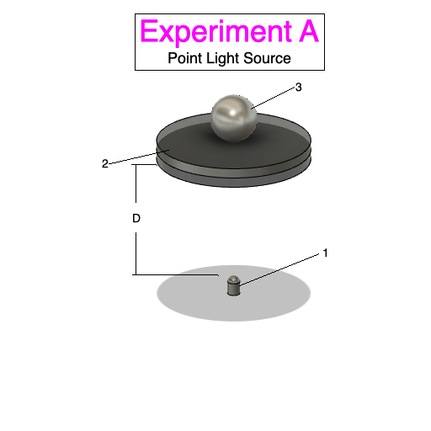
1. White LED facing up, perpendicular
to the thin-film.
2. 62 x 4 mm Ferrolens. With .6 gm/ml
particle density.
3. A 19 mm neodymium sphere magnet
with poles aligned parallel to the glass.
D = 50 mm distance.
Magnetic Pole = 4200 Gauss.

Slide 6
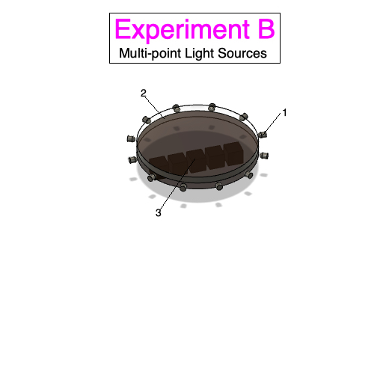
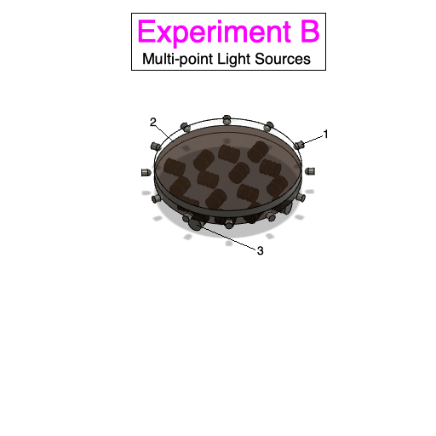
Magnetic pole View
Magnet Matrix View
1. Alternating ring of 36 red, green and blue LED’s
around the circumference of the Ferrolens, facing Inward.
2. 100 x 12 mm Ferrolens with .6 gm/ml particle density. Rear
side of glass is painted flat-black to reduce reflections.
3. A 5-element Halbach array is 1 mm away From the bottom
of the glass. Image made from zoomed-in middle magnetic
pole in the array.
1. A ring of 36 bright white LED’s around the circumference of the Ferrolens, facing Inward.
2. 100 x 12 mm Ferrolens with .6 gm/ml particle density. Rear
side of glass is painted flat-black to reduce reflections.
3. 16 small button magnets arranged in a matrix below Ferrolens. Using various polarization orientations.

Slide 7
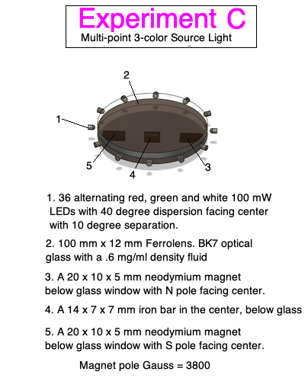

Slide 8
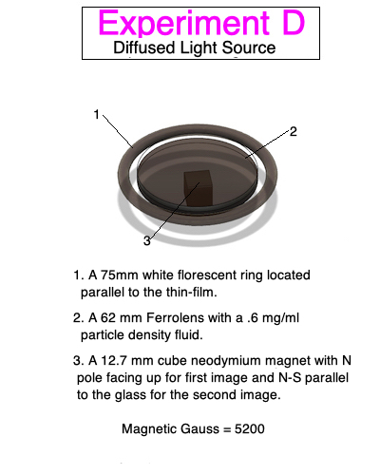
Experiment E

Slide 9
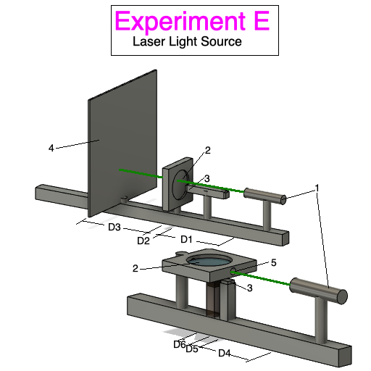
1. Green 5 mW (stated)* laser.
2. 62 x 4 mm Ferrolens with .6 gm/ml
density fluid.
3. 12.7 mm cube magnet N pole (1).
4. Black screen.
5. Entrance hole for laser.
Perpendicular Laser
D1 = 80 cm
D2 = 5 cm
D3 = 60 cm
D4 = 60 cm
D5 = 5 mm (distance 1)
D6 = 10 mm (distance 2)
Magnetic Poles 3800 Gauss
*Measured laser power output 10.5 mW
Parallel Laser

Slide 10
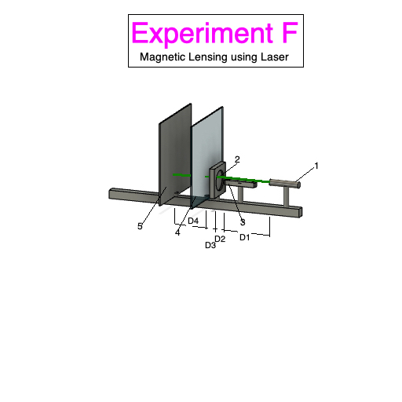
1. Green 5 mW laser (stated)*.
2. 62 x 4 mm Ferrolens with .6 gm/ml particle density.
3. North pole of 12.7 mm cube magnet 5 mm away
from Ferrolens surface.
4. Screen placement at 5 cm for the first test.
5. Screen placement at 50 cm for the second test.
Magnetic pole = 3800 Gauss
*Measured laser power output = 10.5 mW
D1 = 80 cm
D2 = 5 cm
D3 = 5 mm
D4 = 50 cm

Slide 11
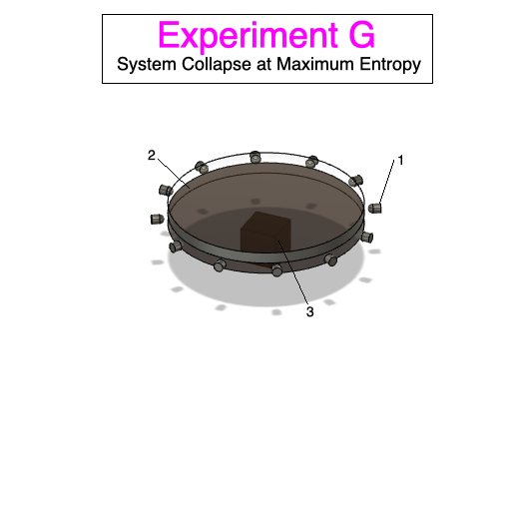
1. A ring of 36 bright white LED’s around the circumference
of the Ferrolens facing inward.
2. 100 x 12 mm Ferrolens with .6 gm/ml particle density.
Rear side of glass is painted flat-black to reduce reflections.
3. A 19 mm cube magnet directly centered, 5mm below the
rear glass surface. Magnetic poles parallel to glass.
Magnetic Pole Gauss = 6000

